Slide 1
Introduction to Machine Learning
One-day training class

Slide 2
Agenda
Introduction to Machine Learning
Supervised Learning and modeling workflow
Supervised Machine Learning with Python
Hands-on exercises and looking at code

Slide 3
Machine Learning
Getting computers to learn about data, then make predictions about new data
Machine Learning is good at “filling in the gaps” between observations. Based on a bunch of observations, can we make inferences on situations or data points we haven’t seen yet?
Different categories of machine learning: Supervised Learning, Unsupervised Learning, Semi-supervised Learning, Anomaly Detection, Reinforcement Learning, Deep Learning

Slide 4
Machine Learning history
Originally part of Artificial Intelligence
A.I. in the 80’s and 90’s had a lot to do with logic, probability, and planning, and more about how computers solve problems
Machine Learning was more practical in nature, using statistics and probability to learn models over data
The 10’s Big Data movement, democratizing of data, and better tools have made ML an integral part of “data science”

Slide 5
Supervised Learning introduction
Training examples that consist of observations and an outcome, learn a function that infers the outcome from the observations.
Observations: typically columnar data of categories, integers, or decimals
Outcome:
Classification: a label (such as yes or no, or diabetes or broken bone or strep throat)
Regression: a value (such as 34% or 33.1)

Slide 6
Formal Definition
Given training examples [x, y] use a machine learning algorithm to approximate f (the “model”) where f(x) = y
x are the independent variables, y is the dependent variable; referred to as the “feature vector”
Measure and optimize to reduce “loss” between f(x) and y
Given a new data point x, use f to predict y

Slide 7
Example: Iris data set
Attributes
sepal length in cm
sepal width in cm
petal length in cm
petal width in cm
class: Iris Setosa, Iris Versicolour, Iris Virginica
50 examples of each
setosa
virginica
5.3, 3.7, 1.5, 0.2, Iris-setosa
x feature vector independent variables
y outcome dependent variable
versicolour
(sl, sw, pl, pw) -> f(x) -> iris type

Slide 8
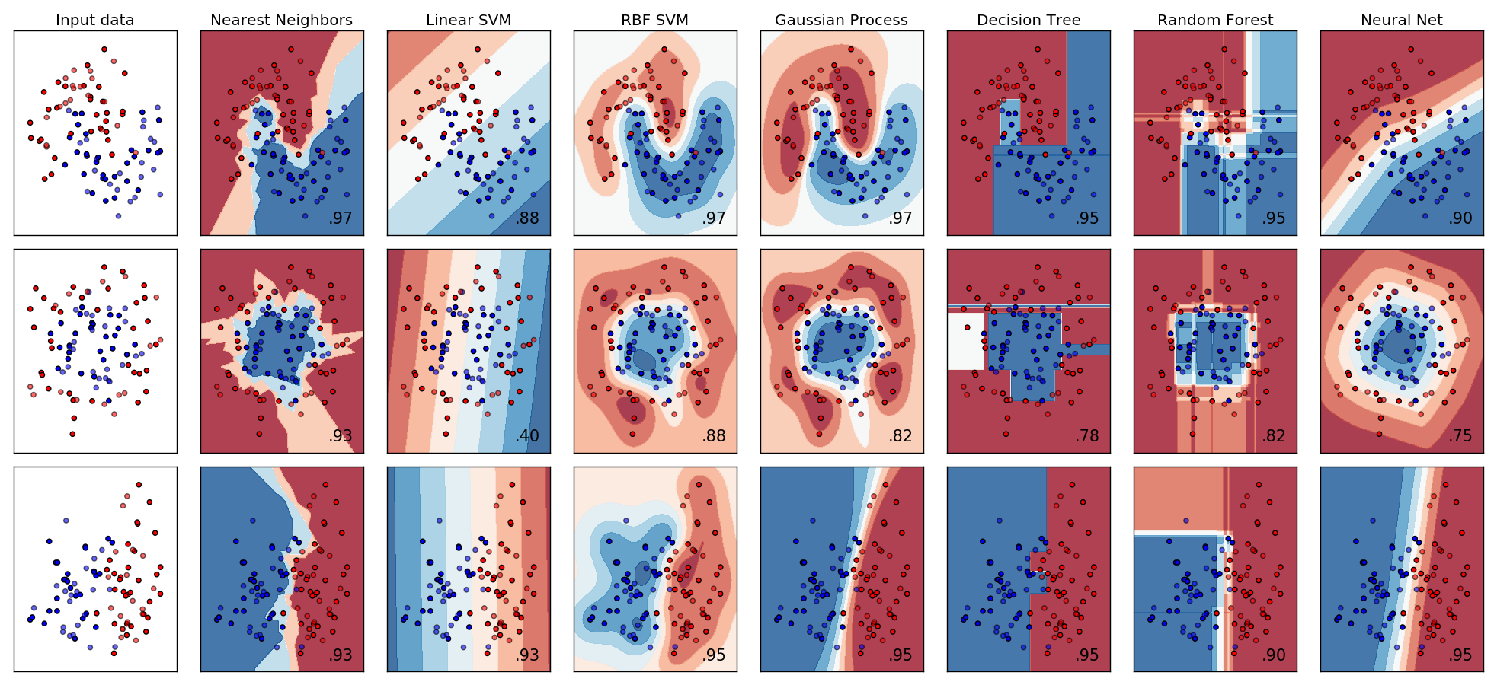
Filling in the gaps
x is the coordinates, y is the category (red or blue). The prediction space is the function the algorithm came up with
Image from http://scikit-learn.org/stable/auto_examples/classification/plot_classifier_comparison.html

Slide 9
Supervised Learning Examples
Disease Diagnosis x is symptoms, lab results, existing diagnoses, demographics y is disease diagnosis
Spam Detection x is email message contents, message metadata y is “spam” or “not spam”
Weather models x is information about recent weather and historical weather y is the temperature

Slide 10
Supervised Learning workflow
Get Raw Data
Feature Engineering
Train a model
Test model
Deploy and use model

Slide 11
Training models
“Training” means using the machine learning algorithm to tune the model to the input data and output data to minimize loss
There are dozens of machine learning algorithms and they have wildly different approaches
Each individual algorithm works the same way for every problem it gets applied to, but what changes are internal tunable parameters that optimize to solving the particular problem
Get Raw Data
Feature Engineering
Train a model
Test model
Deploy and use model

Slide 12
Training models
The training phase typically requires you to pass the algorithm the input data and the output data for a subset of the data (training set)
Then, the remaining test data is used to measure the accuracy
A lot of times the tool handles this splitting for you
Get Raw Data
Feature Engineering
Train a model
Test model
Deploy and use model

Slide 13
Training a model in scikit-learn
from sklearn.ensemble import RandomForestClassifier
X = [[0, 0], [1, 1]] # replace with some data loading
Y = [0, 1] # replace with some data loading
clf = RandomForestClassifier(n_estimators=10)
clf = clf.fit(X, Y)
print ‘f([0,1]) ->’, clf.predict([0, 1])
In scikit-learn most models follow the above scheme: instantiate a classifier, use fit to train it, then predict to use it.
Get Raw Data
Feature Engineering
Train a model
Test model
Deploy and use model

Slide 14
Major Goals of Feature Engineering
Formatting
Most tools like data in a particular way, and likely that way is not how the data is given to you
Sometimes not an issue at all (if the data is already is csv or from a database)
Typically this is solved with some hackish scripts that do data transformation
Examples: convert json into columnar, convert categories into integers
Get Raw Data
Feature Engineering
Train a model
Test model
Deploy and use model

Slide 15
Major Goals of Feature Engineering
Missing data
Sometimes training data has missing values, so not every feature vector has the same information
There are some options, but none of them are really all that good:
Ignore the rows that are missing something – fine if only some are missing
Ignore the columns that are missing something – fine if we think the column isn’t valuable
If the data is categorical, just make missing its own category
If the data is numerical, it may be algorithm dependent on how to handle it
Get Raw Data
Feature Engineering
Train a model
Test model
Deploy and use model

Slide 16
Major Goals of Feature Engineering
Selecting important features
Superfluous features or noisy features can decrease performance
Dependent features (i.e, several features are related) can decrease performance
Some algorithms are resilient to this problem, others are not
Intuition about the features can go a long way (subject matter experts)
Try removing features when tweaking
Dimensionality reduction (more on that later)
Get Raw Data
Feature Engineering
Train a model
Test model
Deploy and use model

Slide 17
Major Goals of Feature Engineering
Scaling
Different features can be of different scale. E.g., we have a feature vector of someone’s height, weight, and age
Some algorithms might be sensitive to scale differences
We use some sort of scaling scheme: linear scaling (set min to 0, max to 1, then scale linearly)
Get Raw Data
Feature Engineering
Train a model
Test model
Deploy and use model

Slide 18
Major Goals of Feature Engineering
Dimensionality reduction
Sometimes the number of features can be a problem
More features means more complexity and training will take too long
Sometimes features are redundant and can bias results to care about those features more
Dimensionality reduction projects feature vectors into new feature vectors with fewer values while trying to minimize information loss
Principal Component Analysis (PCA) is very popular for this
Get Raw Data
Feature Engineering
Train a model
Test model
Deploy and use model

Slide 19
Testing Models
Simple train/test split
K-Fold Cross Validation
Stratified Sampling
Choosing the right loss function
Setting up your testing problem to mimic your real problem.
Get Raw Data
Feature Engineering
Train a model
Test model
Deploy and use model
Notes:
Naïve split sometimes works fine
K-Fold is a smarter way, don’t lose any information for both training and testing. Use all of the samples.
Stratified Sampling can be important when data is imbalanced. Keeps proportion of data intact in both train and test.
Some loss functions have different uses, some are more sensitive to outliers, some are better for regression tasks, some better for classification. Want your measure of ’badness’ to reflect the problem.
Setting up the testing problem to mimic the real problem, something along the lines of making sure that you evaluations are realisitic. If you are designing a system to forecast things in the future, you probably have a dataset of historical data. Simulate a future prediction by choosing some date as your ‘future’ and only using dates before that as your input data.

Slide 20
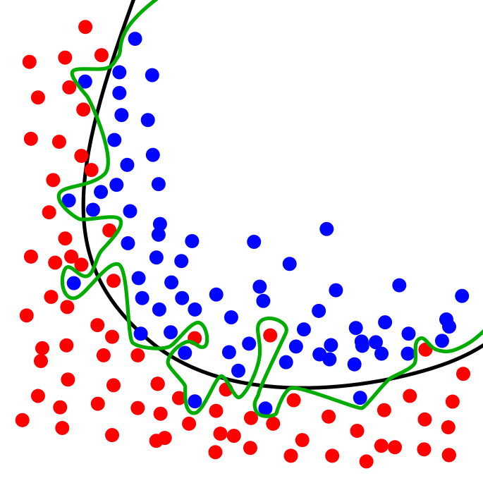

Overfitting: fitting to noise
Overfitting: building an overly complicated or specific model to a problem
Best way to detect this is to leave some test data out from training and test the performance of that. An overfit model will do well with its training data, but poorly with this separate test set.
Overfitting can be combatted by:
“Simplify” the model (different for each algorithm, e.g., decision trees with less depth, less training time on optimization approaches)
Apply a specific approach, such as early stopping, pruning, or dropout
Ensemble methods
Images from https://en.wikipedia.org/wiki/Overfitting

Slide 21
Cheating features / Information Leakage
Sometimes there is a dependent variable that is filled in after knowing what the outcome is
Once going to production, you realize the feature you were counting on for performance aren’t there
For example:
Trying to predict an employee leaving the company
Employee profiles are updated when they leave the company by HR
Historical data dump from HR contains both
Using the updated data would be “cheating”
NEVER trust your results are correct if you are getting 95%+ accuracy on the first try
Always think about how the data will be given to your real-time system and try to make it as realistic as possible

Slide 22
Logistic Regression
Estimates the probability of a true/false or yes/no or other two-category label given a set of features (but can be extended)
It works by fitting a logistic function to the data
Different optimization algorithms can be used to find the weights of the curve
Very simple and easy to use
Image from: https://en.wikipedia.org/wiki/Logistic_regression

Slide 23
Logistic Regression – Multiclass Extension
A standard logistic regression can only output a single number between 0 and 1.
Can be extended to multiple outputs by swapping its output function to a softmax.
Or we can create one logistic regression for every category that we are interested in.
Image from: https://en.wikipedia.org/wiki/Logistic_regression
Notes:
Softmax allows the [0,1] squashing properties of the sigmoid function to be applied to vectors of any dimension. So we can one output per category. The total sum of all entries in an output vector will be 1. So what the softmax does it return a probability distribution across all of our potential classes.
https://en.wikipedia.org/wiki/Softmax_function

Slide 24
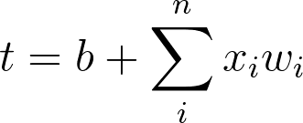
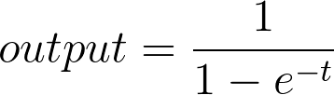
Logistic Regression – Theory
Notes:
Softmax allows the [0,1] squashing properties of the sigmoid function to be applied to vectors of any dimension. So we can one output per category. The total sum of all entries in an output vector will be 1. So what the softmax does it return a probability distribution across all of our potential classes.
https://en.wikipedia.org/wiki/Softmax_function
For the softmax function the numerator is only the value from the index of the correct label, and the denominator is the sum over all of the outputs for the logistic regression.

Slide 25

Decision Trees
Try to model a tree of choices to input data
Tries to make more “interesting” questions near the top
Very susceptible to overfitting
Good with categorical values, but can also work with numerical ones
Model can be interesting to look at
Foundation of Random Forest
Image from: https://en.wikipedia.org/wiki/Decision_tree_learning

Slide 26
Decision Trees - Tuning
Can often set the maximum depth that a tree can grow to
Tree could easily start to develop rules for data points that are outliers
Setting the amount of examples needed to allow a decision to be created
Don’t let the tree split just for one outlier
Image from: https://en.wikipedia.org/wiki/Decision_tree_learning

Slide 27
Random Forest
Train several decision trees (typically hundreds) instead of just one
Make each one a bit different by only considering a subset of features for which is the best to use at the next level (typically square root of the number of features)
Have a maximum depth to have training stop once its made a certain number of splits
Query each tree with input data and count the outcomes: classify on the most frequent outcome
Combats overfitting on typical decision trees
Easily parallelizable
Currently one of the highest performing algorithms and some some of the least pitfalls

Slide 28
Random Forest - Tuning
How many trees to use
Random forest is robust to overfitting, lots of room for exploration in this parameter
Max depth of each tree
Allowing each tree to go too deep (too many splits) could allow the trees to develop arbitrary rules for meaningless data
Number of examples needed to develop splits
Again, a helpful way to avoid creating unnecessary splits for outliers

Slide 29
K-Nearest Neighbor
For a new input item, find the K nearest examples and have them vote for what the outcome should be
Depends on a distance function, which is susceptible to scaling issues
Can handle any kind of data (numerical, text, categorical) as long as a distance function is defined
Picking K is more art than science (try many)
Can be very accurate, but performance of classification is relatively very bad
Image from https://en.wikipedia.org/wiki/K-nearest_neighbors_algorithm

Slide 30
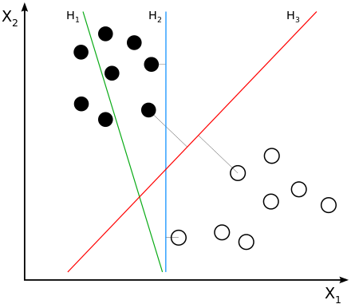
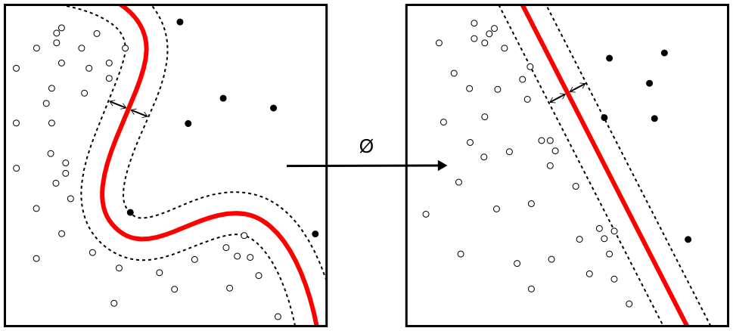
Support Vector Machines
An extension to the linear classifier (finding the equation for a line that splits the two labels)
Tries to maximize the distance between the two groups with the line, instead of just finding any line
Stretches the features into a new features with a “kernel” with the goal to make the problem linearly separable
Very robust and accurate, relatively popular
Performance can be bad in some situations
Images from: https://en.wikipedia.org/wiki/Support_vector_machine

Slide 31
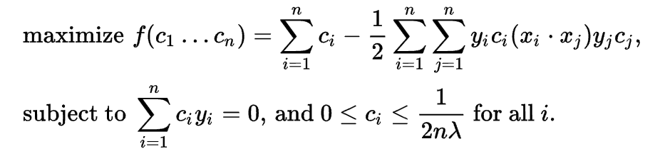
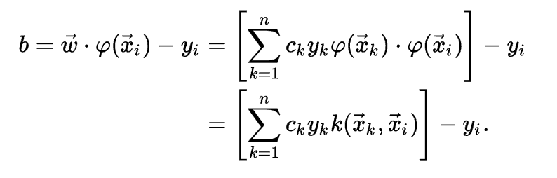
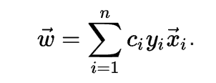
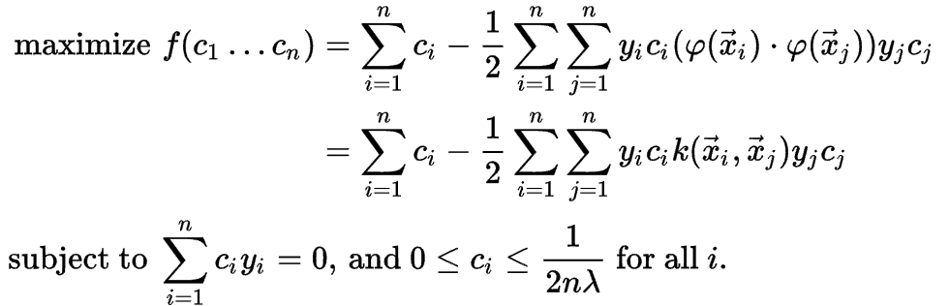
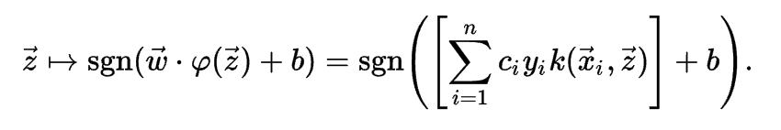
How SVMs work
Notes:
This slide is meant as a joke. Just treat the SVM as a black box.

Slide 32
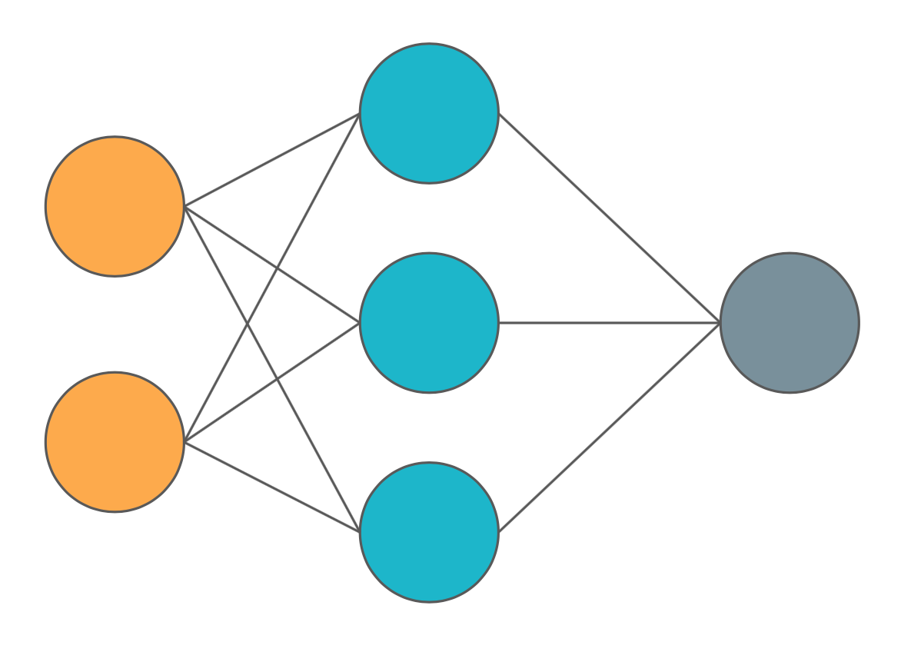
Artificial Neural Networks
A chain of simple calculations
Inspired by a biological brain, each neuron is a simple unit but together they are powerful
The output of each unit (neuron) becomes the input for the next series of units
Each computation looks similar to a logistic regression
Notes:
Data flows through network from start to finish
Many, many simple calculations.

Slide 33
Artificial Neural Networks - Tuning
Very susceptible to different hyperparameter choices
Learning rate – how quickly to allow units to change as they go through training examples
Too fast – units could be unstable
Too slow – units may not learn
Number of units
Too many – overfits easily
Too few – will underperform
Notes:
Learning rate – problem dependent will need to play with it for each new task

Slide 34
pandas
Data analysis library for Python
Open source and widely used
Focus on performance and ease of use
Major component is the DataFrame, which is based on the concept from the R programming language
DataFrames are labeled two-dimensional arrays where rows are records and columns are features
Can create data frames in multiple ways: from csv, from python lists, from numpy arrays, from a database connection
Easily summarize data, filter data, and plot data directly from data frames
Perfect for preparing data for scikit-learn

Slide 35
scikit-learn introduction
Data mining and data analysis library
Widely used for its machine learning algorithms
Also has data preparation tools, testing tools, and other conveniences
Very consistent APIs across all the algorithms (especially for an open source project)
Very good and complete documentation

Slide 36
What to look into next
Unsupervised Learning – learning things about data without having it be labeled
Deep Learning – New age of artificial neural networks that find high-level abstractions of data; good at media like image analysis
Statistics for data science – Statistics are very useful in data science and complement machine learning

